Slide 1
Nakuja Internship 2026
Solid Propulsion Team
Weekly report #7
Presented by: Lynn Talam
July 31, 2026

Slide 2
Tasks completed this week
3D printed top and bottom plate for new casting tool design
Outlined procedure for N4 Version 2 Solid Rocket Booster production
3D print trigger circuit casing
Mandrel fabrication to fit new dimensions
One grain static test (control and suppressant)

Slide 3
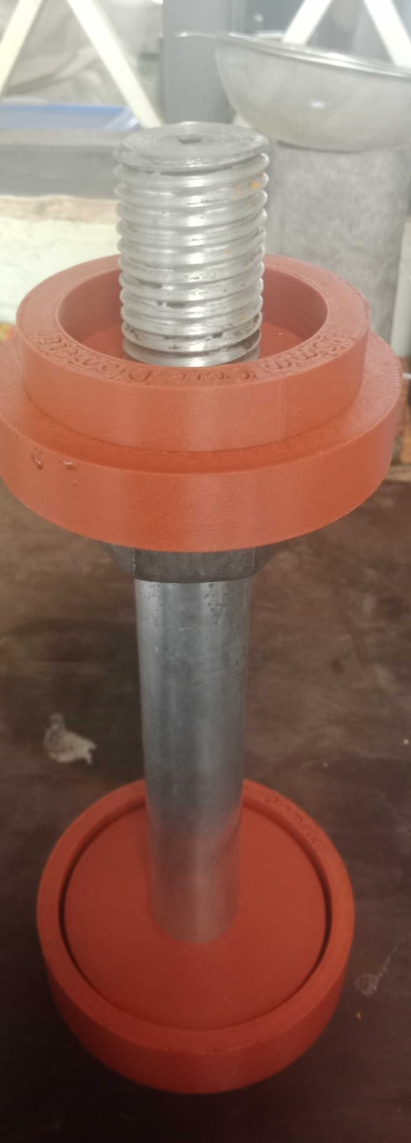
3D printed top and bottom plate for the new casting tool design
Purpose: Due to change in dimension for the grain diameter (Outer diameter increased from 86 mm to 104 mm), the team had to re-design the casting tools to fit this dimensions. One out of four casting tools have been printed.
Result:

Slide 4
2. Outlined procedure for N4 Version 2 SRB manufacturing
Reason for Version 2 change:
Change in casing material from Aluminium A6063-T5 to stainless steel G 304 schedule 10
Increase in motor outer diameter from 100 mm to 114 mm
Improvement in grain preparation (curing under pressure, fine milled KNO3)
Reduction in number of grains from 5 to 4 to reduce peak thrust to the target value of ~2322N
Documentation for critical path to N4 version 2 SRB manufacturing: https://github.com/nakujaproject/Internship-2026/blob/main/01_SOLID_PROPULSION/Static_Tests/Four_Grain_Test/Critical%20Path%20For%20N4%20Version%202%20Solid%20Rocket%20Booster%20(3).pdf

Slide 5
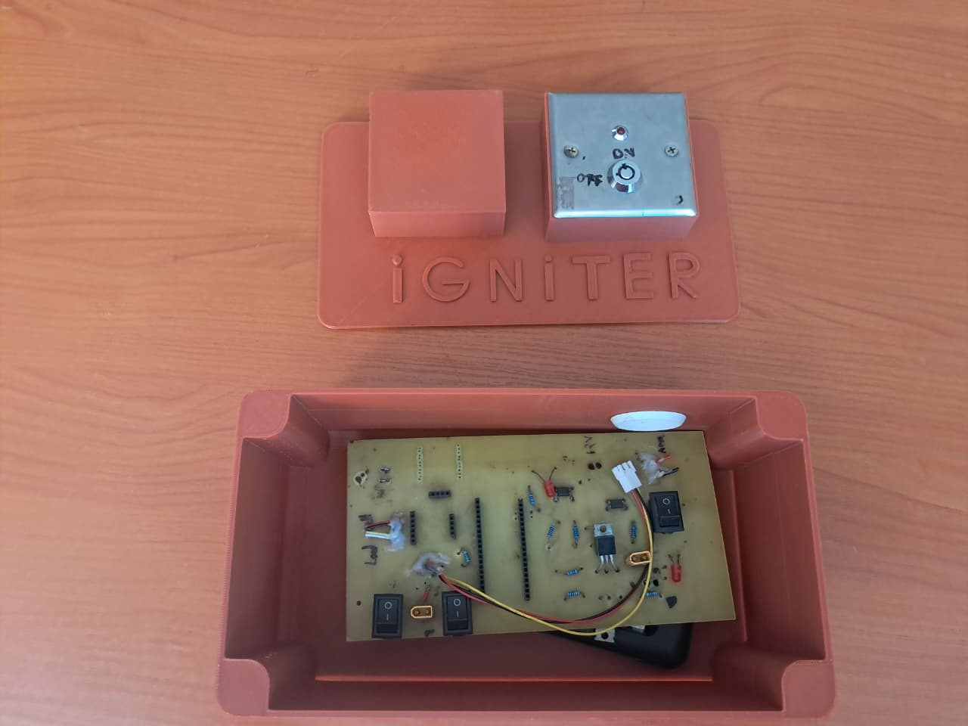
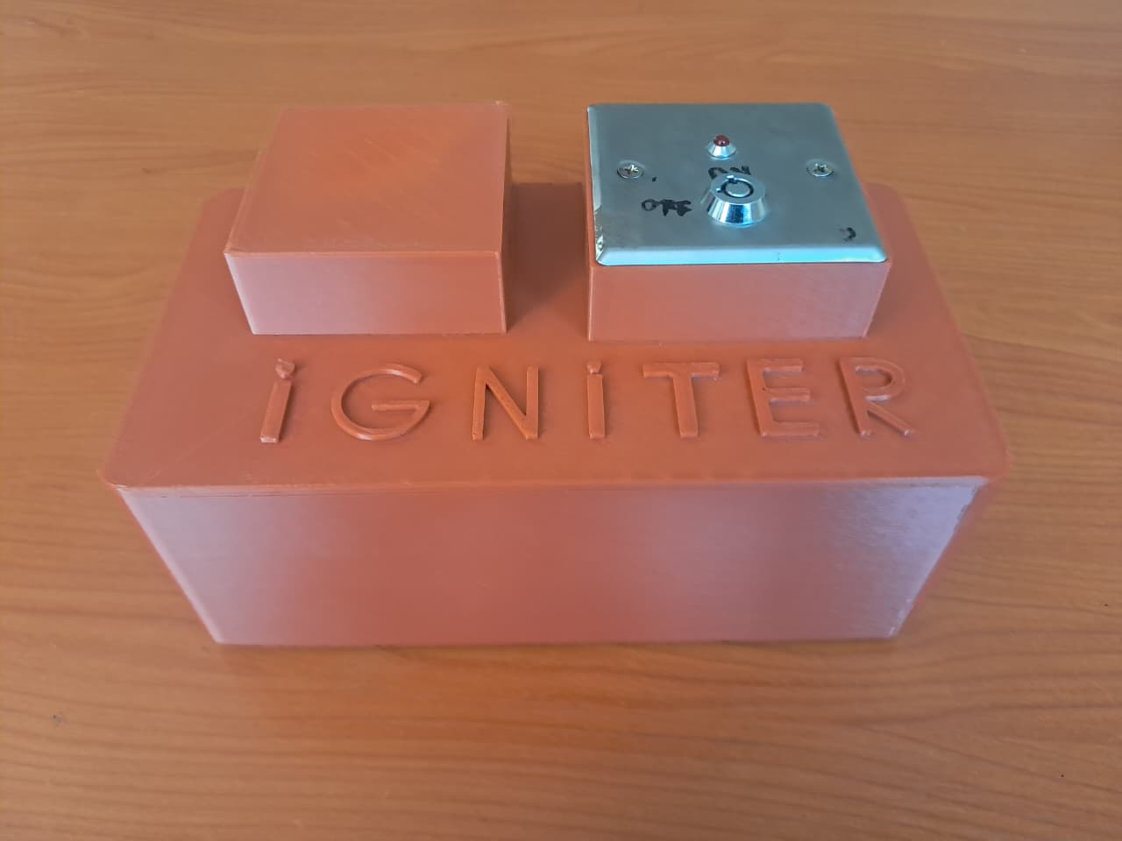
3. 3D print igniter circuit casing
Purpose: In order to protect the ignition circuit during static test and launch, the ignition sub-team designed and outer casing to protect the PCB during field tests.
Result:

Slide 6
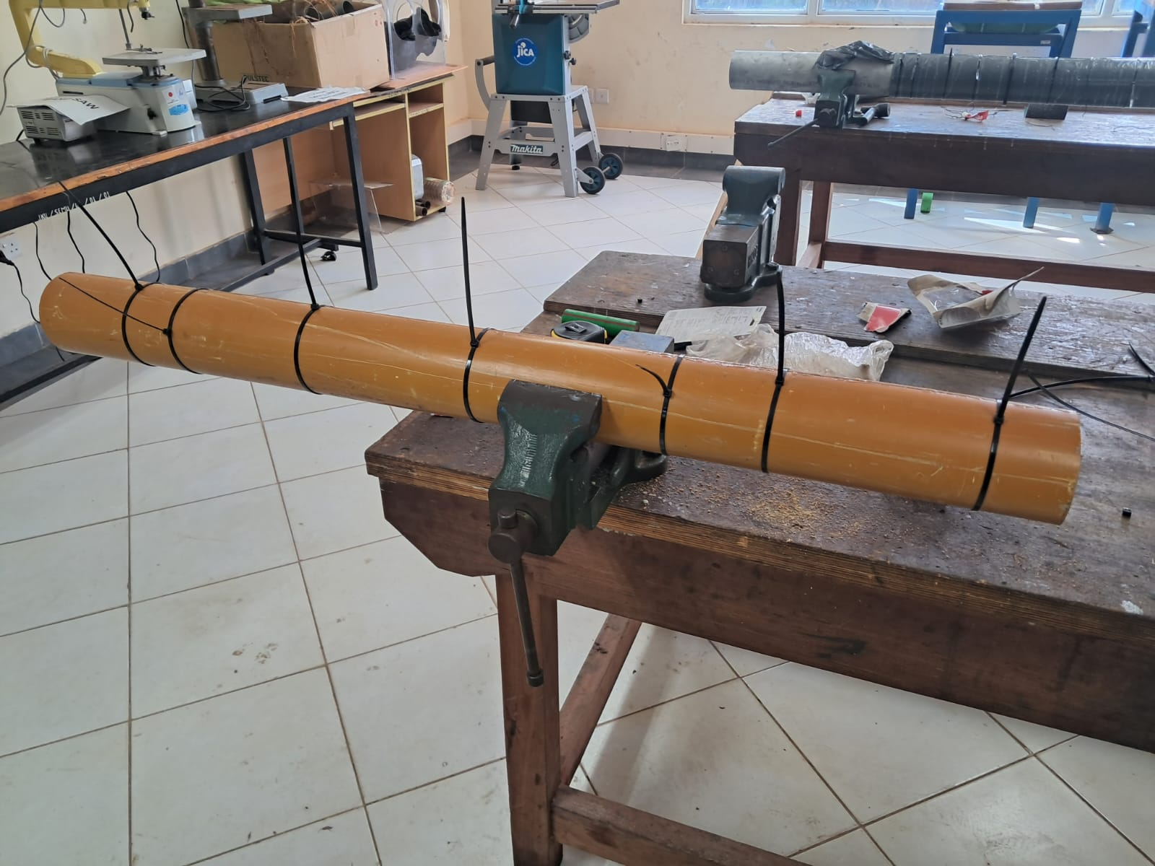
4. Mandrel fabrication to fit new dimensions
Purpose: In order to fit the new dimensions for the outer diameter of the grain, the propellant subteam fabricated a new mandrel which will be used during liner fabrication.
Result:

Slide 7
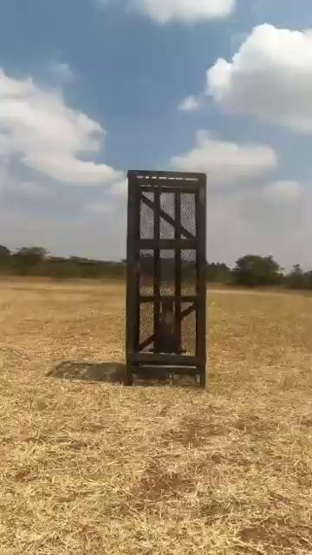
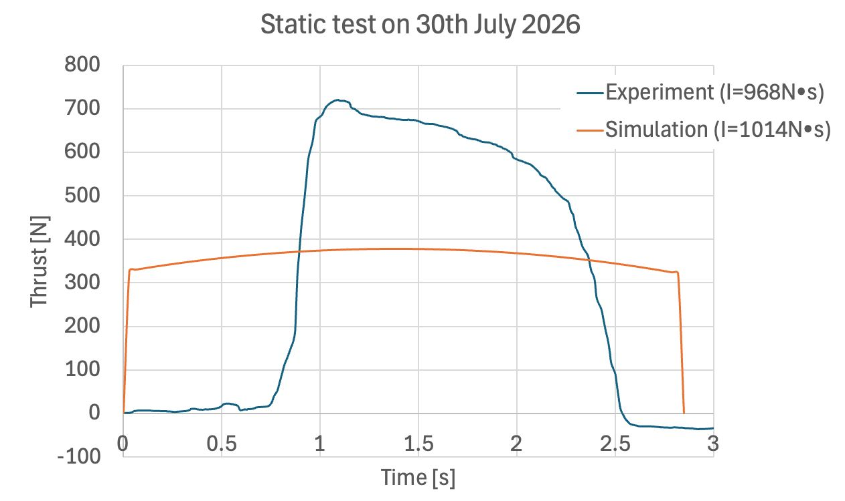
5. One grain static test #6: Control test
Purpose: Due to exposure and entry of moisture during the first control static test, the propellant subteam prepared another grain and it was fired during the 6th static test. This grain will be used as our reference point when making any potential changes to the grain.
Result:

Slide 8
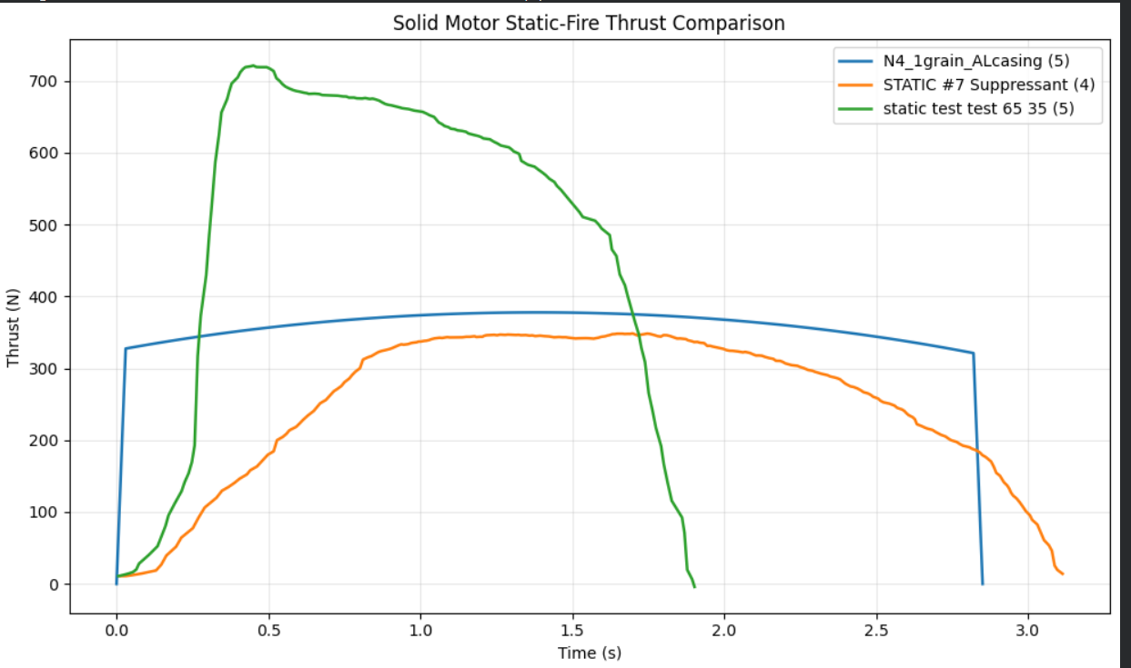
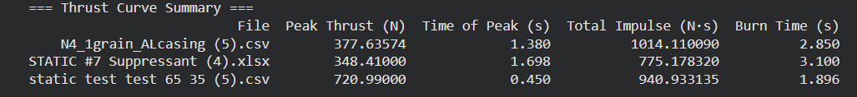
6. One grain static test #7: Addition of suppressant (Sodium Bicarbonate)
Purpose: Following the control static test, a second test was carried out using a KNSB grain with 1% sodium bicarbonate suppressant added to evaluate whether it’ll reduce thrust output.
Result: The SRM produced ~76% of the theoretical ISP and the peak thrust was slightly below simulated values indicating excellent performance of the suppressant.
Unfortunately, no video footage was captured as the SD card in the GoPro was full at the time of the static test.

Slide 9
Next week’s tasks
Cooking of grains for 4 grain static test
Old grains disposal
Purchasing of items
Liner preparation
Liner thickness testing (Burn test)
Ignition circuit fabrication
Ignitor preparation and testing

Slide 10
Challenges experienced
Poor internet connectivity.
Supervisors’ note:
Visit Solid Propulsion github projects @ https://github.com/orgs/nakujaproject/projects/26 to review the tasks done.

Slide 11
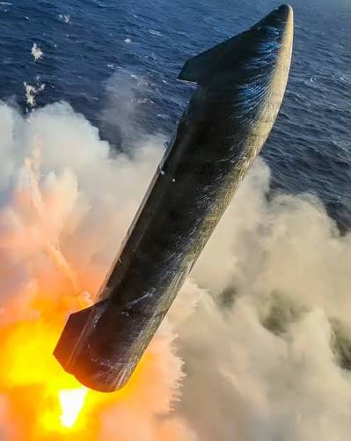
Thank you for your attention!

